Slide 1

Apregoar
Update 28 julho 2022
Localization of
incidents within a community
Callie Wentling
Professor Marco Painho

Slide 2
Overview
Motivation
Data
Corpora
External Gazetteer
Internal Gazetteer
Data Model
Application
Setup
Publish
Contextualize
Explore
Manage
Report
Outline
Status
Next steps

Slide 3
Motivation
Is there value in integrating a spatial component to news databases?
The association of place will provide a new dimension of understanding of incident distribution at a local level.
Discovery for users
Context to journal readers
Tool for researchers
Contribute to geointelligence of the area
Publishers integrating spatial news may provide an improved user experience to readers, expand readership, and better manage spatial, temporal, and thematic coverage of stories.

Slide 4




Data: Corpora
Jan - March 2022
CML Notícias
Stories: 92
Instances: 123
Facebook posts
Stories: 39
Instances: 45
*Yet incomplete for Q1
Online Journal
Stories: 143
Instances: 360
Freguesia Notícias
Stories: 4
Instances: 5
Attribute | CML | JFC | Mensagem | JFCdO
Title | Yes | Sometimes | Yes | Yes
Summary | No | No | Usually | Usually
Publish date | Yes | Yes | Yes | Yes
Section(s) | Yes | No | Yes | Yes
Tags | Yes | No | No | No
Author | No | No | Yes | No
Link | Yes | Yes | Yes | Yes

Slide 5
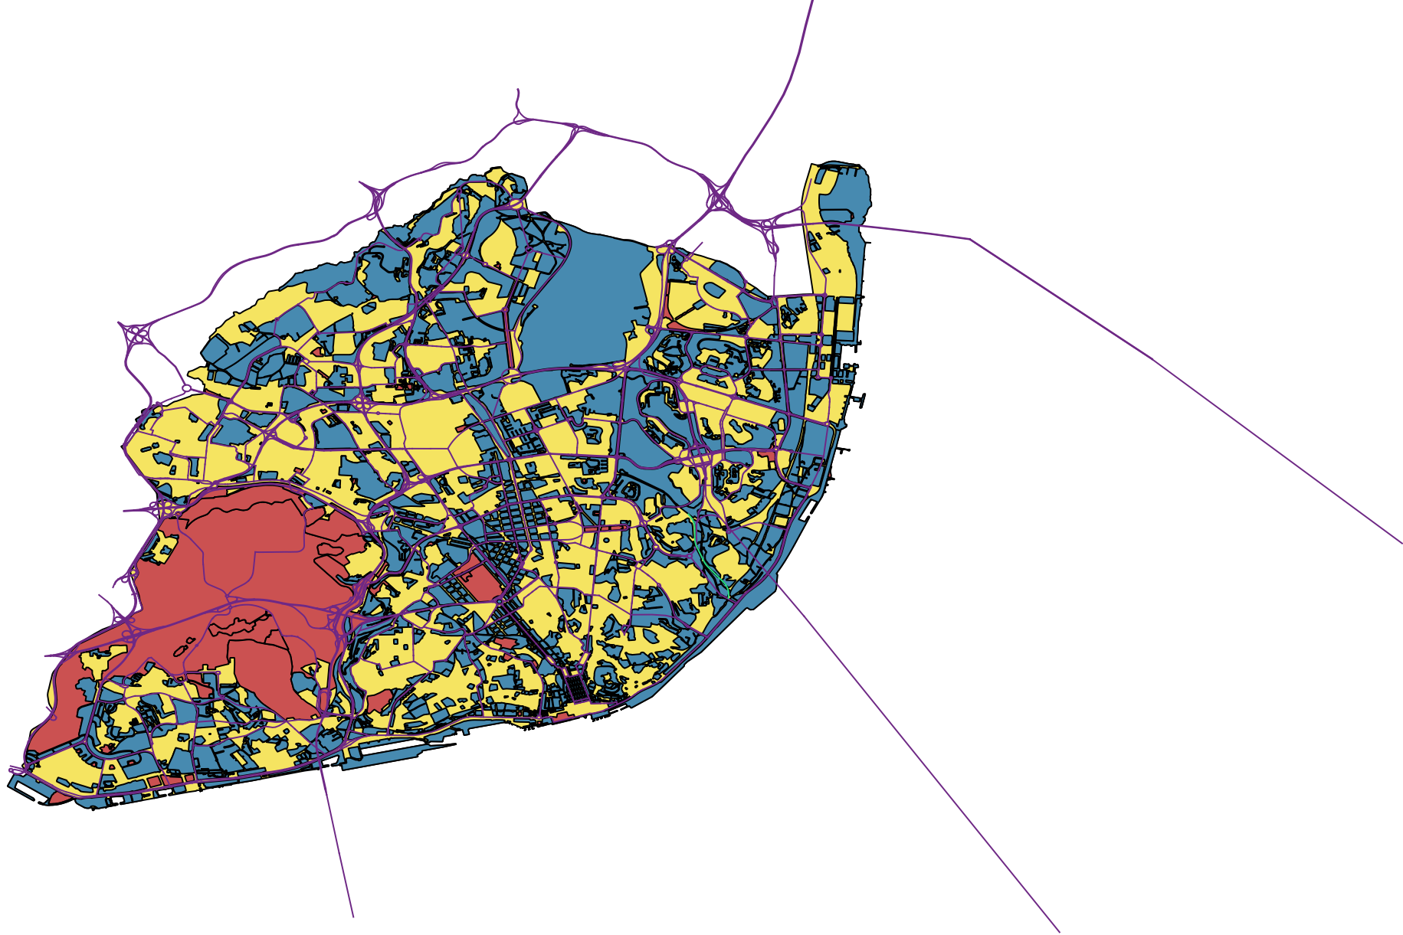

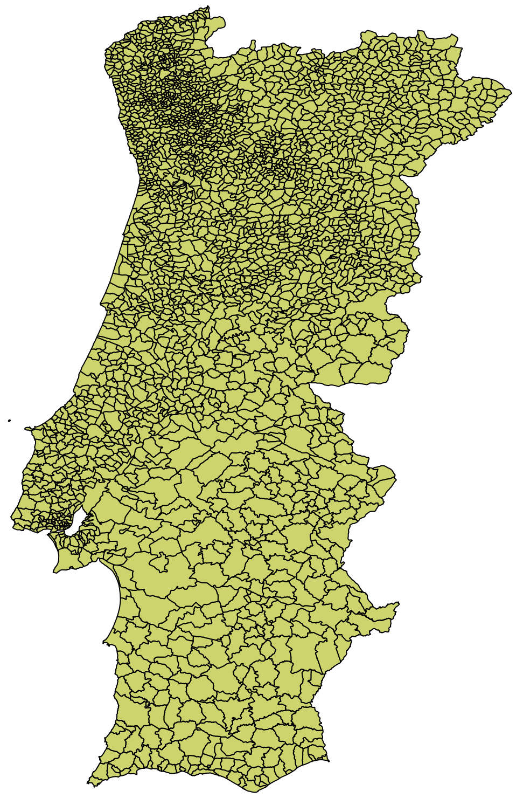

Data: Gazetteers
Source | Name | # Original | # Loaded | Transformation | Geo | EPSG
DG Território | CAOP 2019 |  | 528 | Unioned polygons, at freguesia, municipality, distrito levels, and national (continental) areas, created AML area, transformed to 4326 | Area | 3763
DG Território | CAOP 2017 |  | 191 | “ ” | Area | 3763
CML Geodados | Grande Parques | 195 | 195 | - | Area | 4326
CML Geodados | Ambiente DMEVAE | 3456 | 3456 | - | Area | 4326
Geonames | PT (5 apr 2022) |  | 3786 | Intersection with Lisbon study area | Point | 4326
Study area of Lisbon
Distrito de Lisboa ∪ Área Metropolitana de Lisboa.

Slide 6
Methodology: Toolset
Web App
Spatial data backend: PostGIS, PostGreSQL
GeoNode: GeoServer
Client Libraries: Open Layers
Language: Python, SQL, Javascript
WSGI Server
Notes:
This is the current working data model. The items in red are expected to be provided by the news data sources.

Slide 7
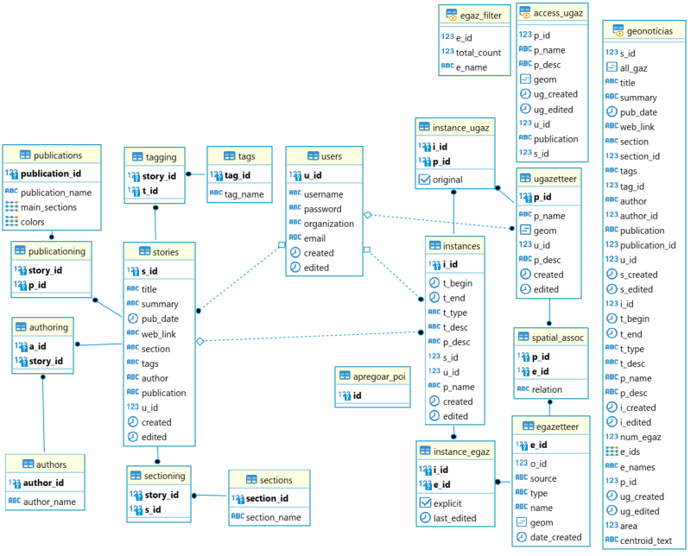
Methodology: Data model
Notes:
This is the current working data model. The items in red are expected to be provided by the news data sources.

Slide 8
Methodology: Process
Corpora
Context Tool
Geo-Corpora DB
Publish Tool
Explore Tool
Export /
Connect
Dashboard Tool
Gazetteer
Notes:
This is the current working data model. The items in red are expected to be provided by the news data sources.

Slide 9
Tools: Publish
Create
Story attributes
Extract & save new geometries
Spatially relate geom w gaz
Link exists in DB?
Extract & save datetime, text
Associate existing geometries
Distribute As into tables in DB
Validate user input
Load stories created by user
Localize
Instance attributes
Dash-board
Load gazetteers for association
WMS layer,
WFS popups
Notes:
This is the current working data model. The items in red are expected to be provided by the news data sources.

Slide 10
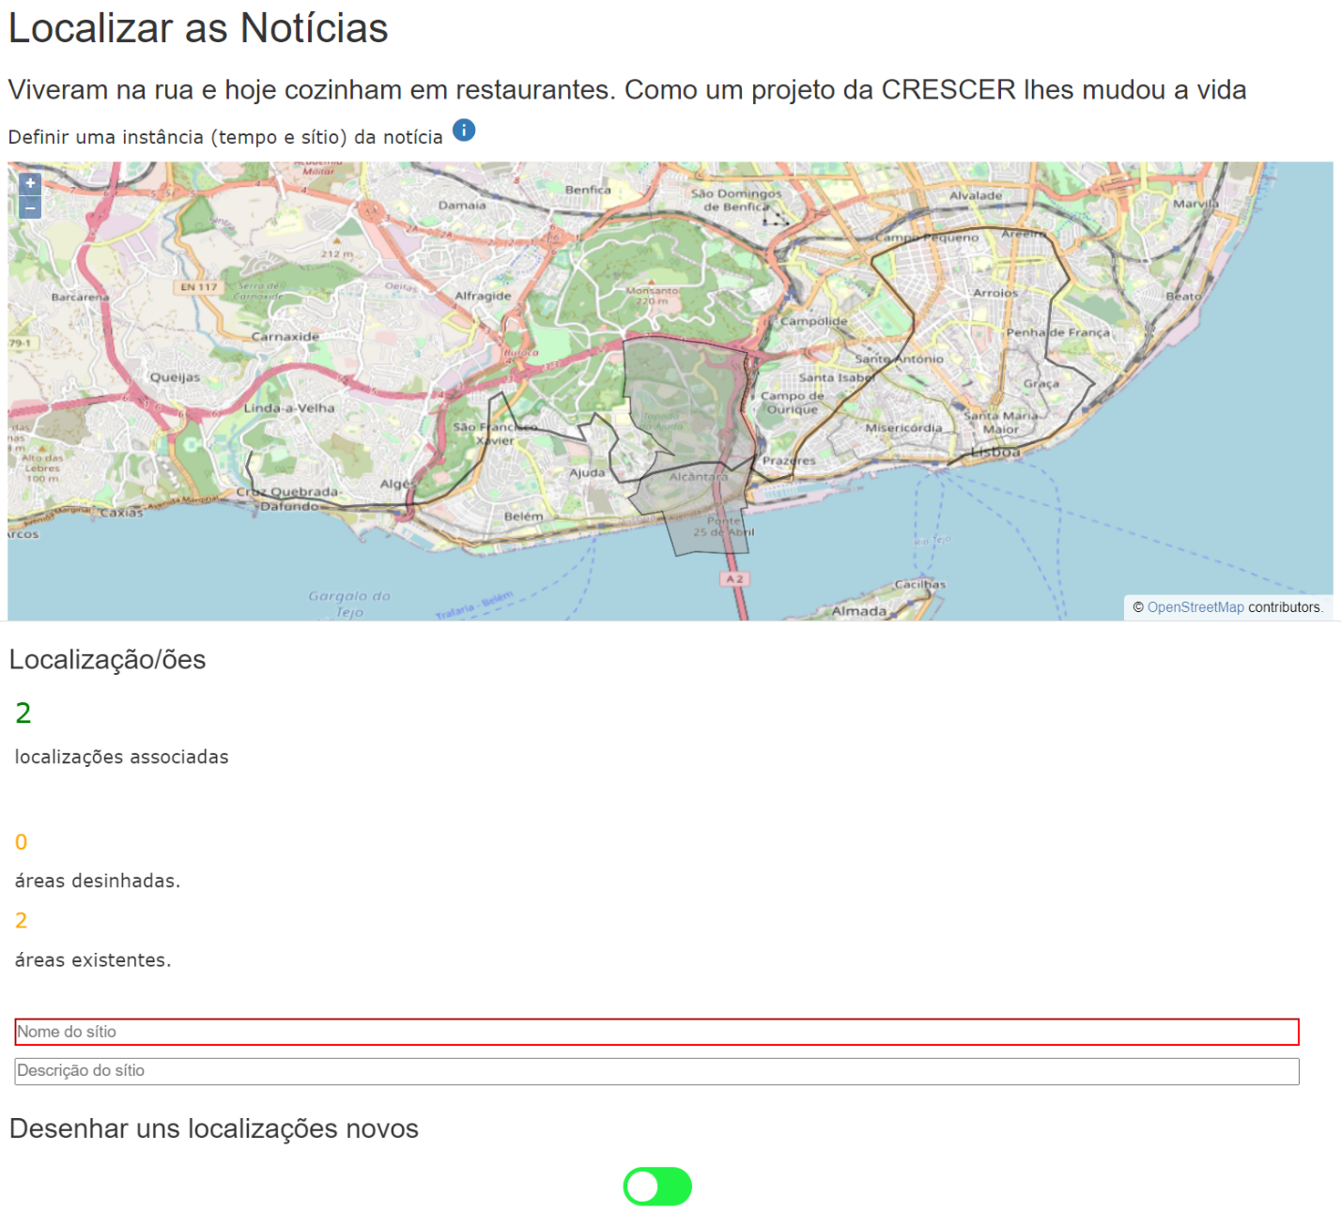
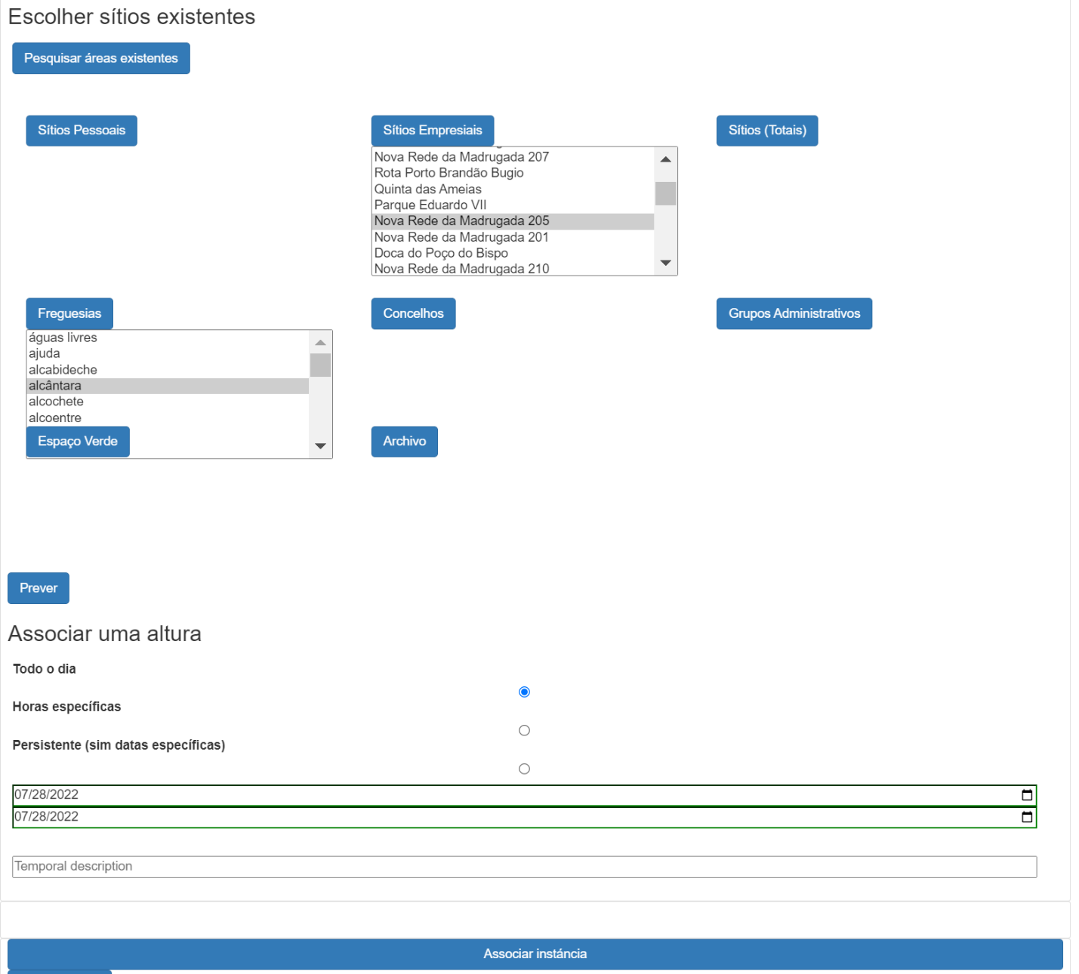
Tools: Publish

Slide 11
Tools: Explore
Load explore
If admin filter:
apply “spatial_assoc” relation
If inst date range: apply
If inst thematic: apply
Load options for thematic attr’s
If custom search area: determine & apply spatial function
If ptype: Filter
If sem def: include stories w/out inst’s
Load date ranges of stories, inst’s
Base query of instances
If pubdate: apply
If thematic: apply
Select story
Package as JSON
If inst’
If search:
find matches in any/all text attributes
View details of story and associated instances
Load recent results
Filters selected
Prepare results and package as JSON
Click deets
Explore Map
Click map
Load popups w details of all loaded results at click point
Notes:
This is the current working data model. The items in red are expected to be provided by the news data sources.

Slide 12
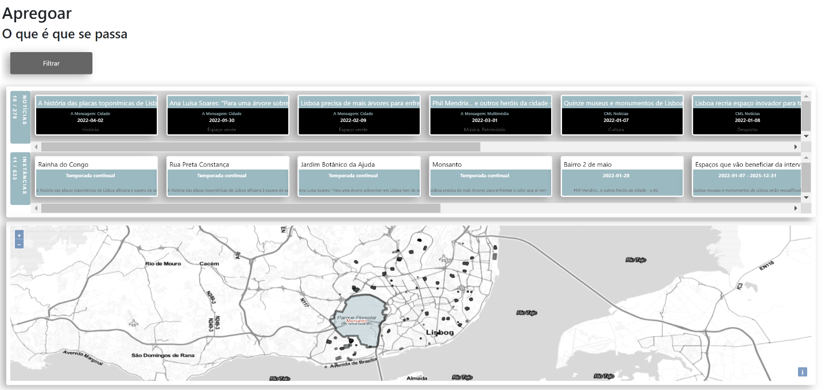
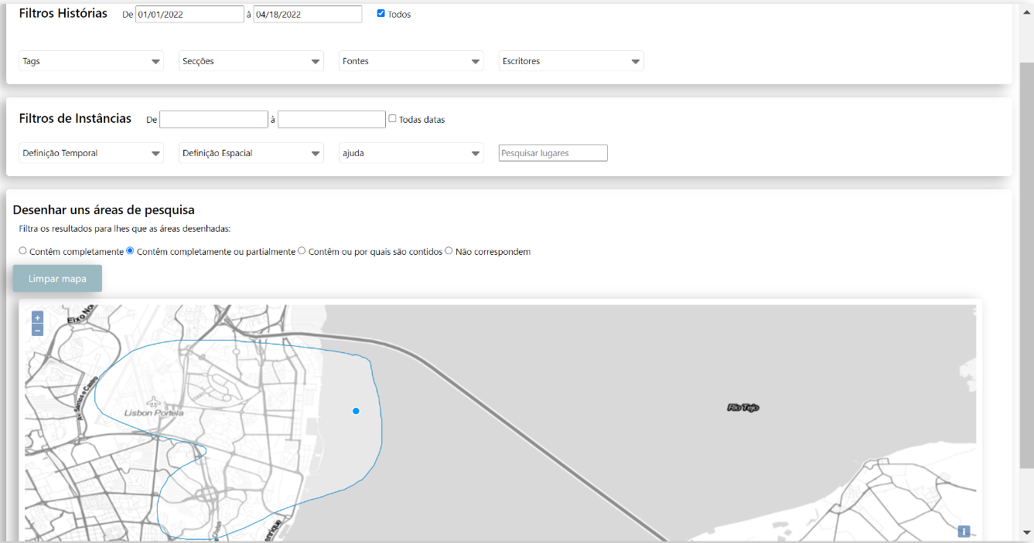
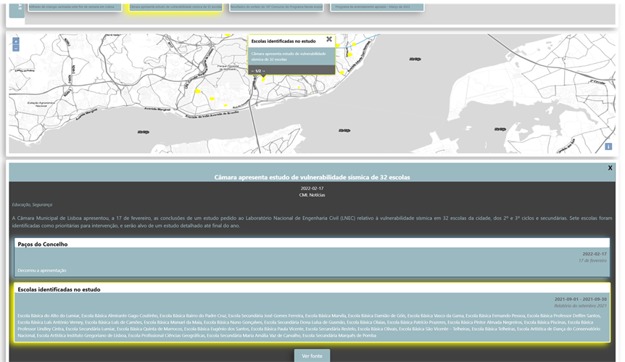
Tools: Explore

Slide 13
Tools: Context
Selected story
Process explore()
Identify story_id, validate, and load
Filters selected
View details of story and associated instances
Identify and load overlap egaz
Explore J Map
Click deets
História
Load pub/area specific explore
Click map
WFS layer,
WFS popup
Identify publication
Load popups w details of all loaded results at click point
Similar area
Identify selected area
Notes:
This is the current working data model. The items in red are expected to be provided by the news data sources.

Slide 14
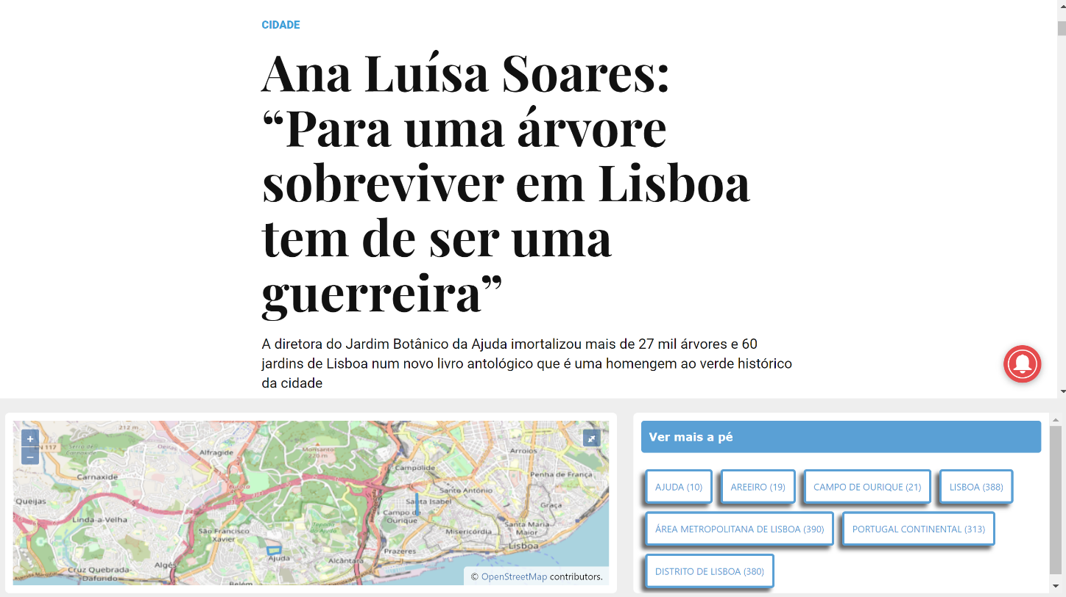
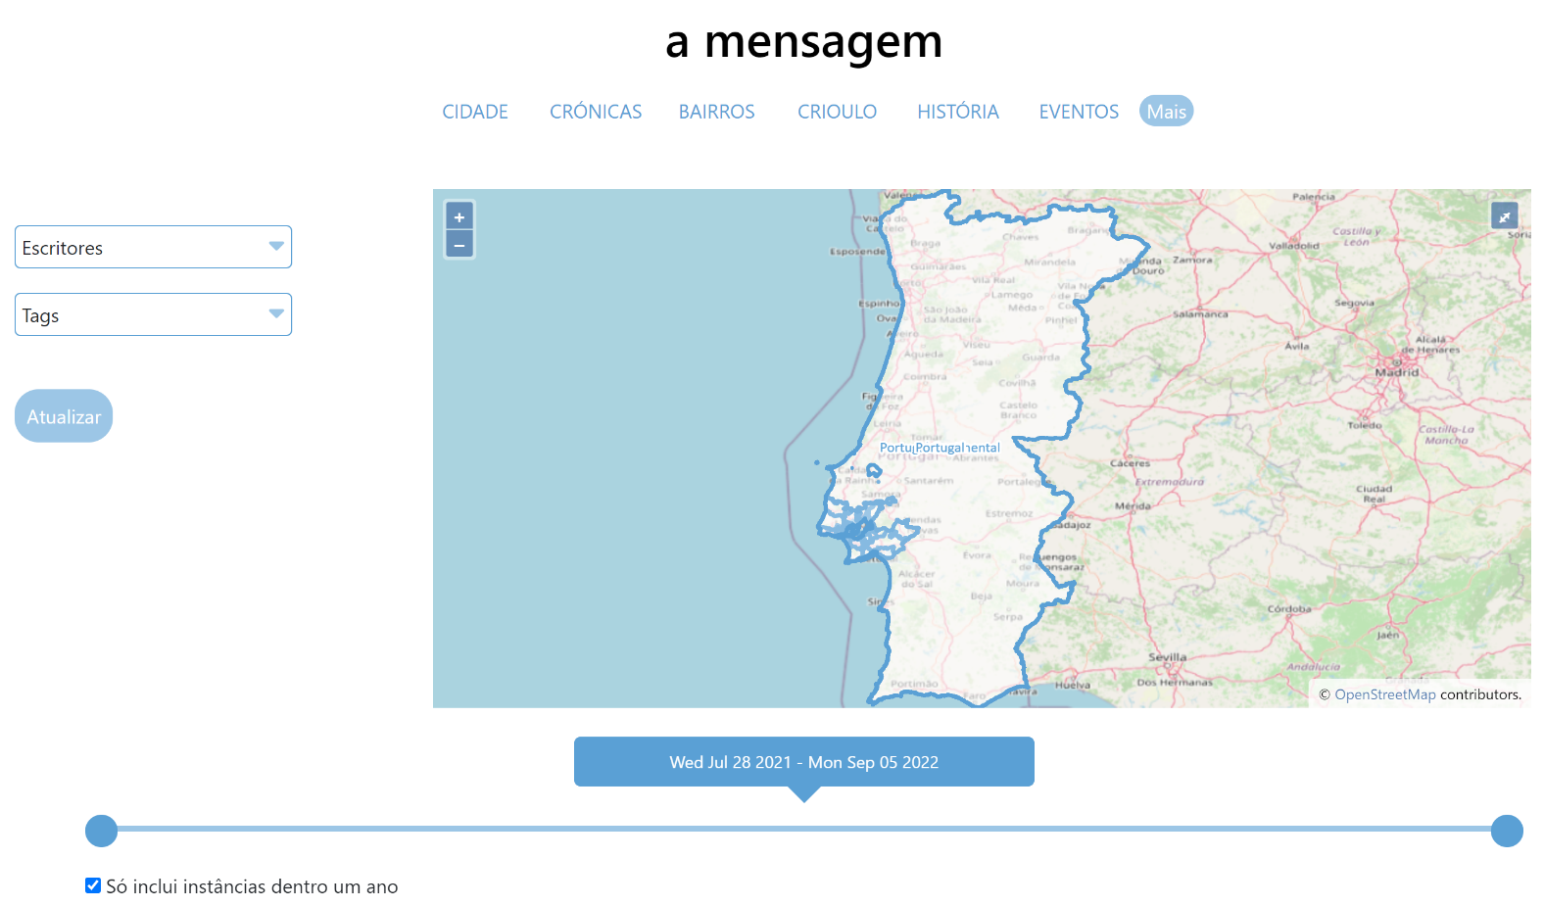
Tools: Explore

Slide 15
Tools: Dashboard
Hotspots
API
Download
Saved searches
Temporal animations
Word association in space: identification of new trends or neighborhoods
Notes:
This is the current working data model. The items in red are expected to be provided by the news data sources.

Slide 16
Report: Outline
Introduction
Literature review
Citizen empowerment
Spatial information
News localization
Web application
Intervention Description
Tools
Distinction from previous work
Public participation
Nuanced “place”
Knowledge facilitation
Features
Methodology
Study area
Model design
GIS design
Data preparation
Architecture
Web interface
Front end
Back end
Manipulation
Data Collection
Preprocessing
Initialization of development environment
Tool design
Testing
Validation
Results
Future Opportunities
Validation
Application to GeoIntelligence
Sub-article definitions
Recommended extraction of place
Incorporation of historical stories
Statistical Analysis
Conclusion

Slide 17
Report: Progress
None.

Slide 18
Next steps
Feedback: welcome
Roadblocks: time
Report progression: none
Future development plans: lots
Strategy for completion: ?

Slide 19

Thank you!
Discussion
Address: Campus de Campolide, 1070-312 Lisboa, Portugal
Tel: +351 213 828 610 | Fax: +351 213 828 611

